Slide 1
NEURAL NETWORKS

Slide 2
INTRODUCTION
Neural networks reflect the behavior of the human brain, allowing computer programs to recognize patterns and solve common problems in the fields of AI, machine learning, and deep learning.
Neural networks rely on training data to learn and improve their accuracy over time. However, once these learning algorithms are fine-tuned for accuracy, they are powerful tools in computer science and artificial intelligence, allowing us to classify and cluster data at a high velocity.
Notes:
Neural networks reflect the behavior of the human brain, allowing computer programs to recognize patterns and solve common problems in the fields of AI, machine learning, and deep learning.
Neural networks, also known as artificial neural networks (ANNs) or simulated neural networks (SNNs), are a subset of machine learning and are at the heart of deep learning algorithms. Their name and structure are inspired by the human brain, mimicking the way that biological neurons signal to one another.
Artificial neural networks (ANNs) are comprised of a node layers, containing an input layer, one or more hidden layers, and an output layer. Each node, or artificial neuron, connects to another and has an associated weight and threshold. If the output of any individual node is above the specified threshold value, that node is activated, sending data to the next layer of the network. Otherwise, no data is passed along to the next layer of the network.
Neural networks rely on training data to learn and improve their accuracy over time. However, once these learning algorithms are fine-tuned for accuracy, they are powerful tools in computer science and artificial intelligence, allowing us to classify and cluster data at a high velocity. Tasks in speech recognition or image recognition can take minutes versus hours when compared to the manual identification by human experts. One of the most well-known neural networks is Google’s search algorithm.

Slide 3
History
1943: Warren S. McCulloch and Walter Pitts published “A logical calculus of the ideas immanent in nervous activity
1958: Frank Rosenblatt is credited with the development of the perceptron, documented in his research, “The Perceptron: A Probabilistic Model for Information Storage and Organization in the Brain”
1974: While numerous researchers contributed to the idea of backpropagation, Paul Werbos was the first person in the US to note its application within neural networks within his PhD thesis
1989: Yann LeCun published a paper.
Notes:
The history of neural networks is longer than most people think. While the idea of “a machine that thinks” can be traced to the Ancient Greeks, we’ll focus on the key events that led to the evolution of thinking around neural networks, which has ebbed and flowed in popularity over the years:
1943: Warren S. McCulloch and Walter Pitts published “A logical calculus of the ideas immanent in nervous activity (PDF, 1 MB) (link resides outside IBM)” This research sought to understand how the human brain could produce complex patterns through connected brain cells, or neurons. One of the main ideas that came out of this work was the comparison of neurons with a binary threshold to Boolean logic (i.e., 0/1 or true/false statements).
1958: Frank Rosenblatt is credited with the development of the perceptron, documented in his research, “The Perceptron: A Probabilistic Model for Information Storage and Organization in the Brain” (PDF, 1.6 MB) (link resides outside IBM). He takes McCulloch and Pitt’s work a step further by introducing weights to the equation. Leveraging an IBM 704, Rosenblatt was able to get a computer to learn how to distinguish cards marked on the left vs. cards marked on the right.
1974: While numerous researchers contributed to the idea of backpropagation, Paul Werbos was the first person in the US to note its application within neural networks within his PhD thesis (PDF, 8.1 MB) (link resides outside IBM).
1989: Yann LeCun published a paper (PDF, 5.7 MB) (link resides outside IBM) illustrating how the use of constraints in backpropagation and its integration into the neural network architecture can be used to train algorithms. This research successfully leveraged a neural network to recognize hand-written zip code digits provided by the U.S. Postal Service.

Slide 4
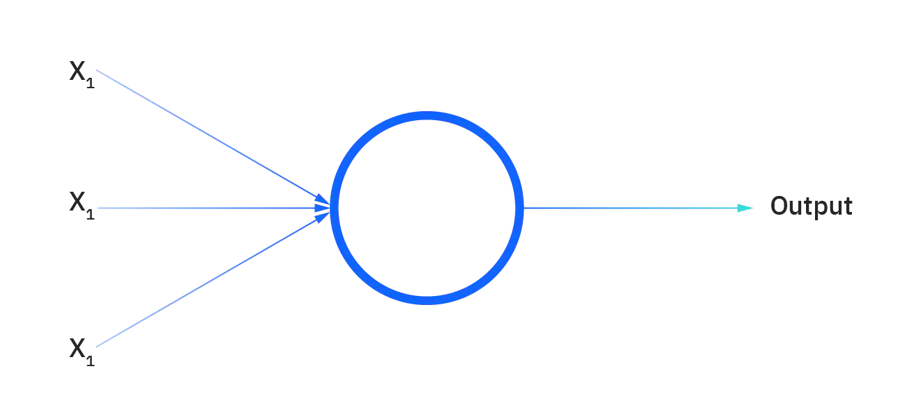
TYPES
The perceptron
Feedforward neural networks, or multi-layer perceptrons (MLPs)
Convolutional neural networks (CNNs)
Recurrent neural networks (RNNs)
Notes:
Neural networks can be classified into different types, which are used for different purposes. While this isn’t a comprehensive list of types, the below would be representative of the most common types of neural networks that you’ll come across for its common use cases:
The perceptron is the oldest neural network, created by Frank Rosenblatt in 1958. It has a single neuron and is the simplest form of a neural network:
Feedforward neural networks, or multi-layer perceptrons (MLPs). They are comprised of an input layer, a hidden layer or layers, and an output layer. While these neural networks are also commonly referred to as MLPs, it’s important to note that they are actually comprised of sigmoid neurons, not perceptrons, as most real-world problems are nonlinear. Data usually is fed into these models to train them, and they are the foundation for computer vision, natural language processing, and other neural networks.
Convolutional neural networks (CNNs) are similar to feedforward networks, but they’re usually utilized for image recognition, pattern recognition, and/or computer vision. These networks harness principles from linear algebra, particularly matrix multiplication, to identify patterns within an image.
Recurrent neural networks (RNNs) are identified by their feedback loops. These learning algorithms are primarily leveraged when using time-series data to make predictions about future outcomes, such as stock market predictions or sales forecasting.

Slide 5
Applications
Function approximation, or regression analysis, including time series prediction and modeling.
Classification, including pattern and sequence recognition, novelty detection and sequential decision making.
Data processing, including filtering, clustering, blind signal separation and compression.
Notes:
Neural networks can be used in different fields. The tasks to which artificial neural networks are applied tend to fall within the following broad categories:
Function approximation, or regression analysis, including time series prediction and modeling.
Classification, including pattern and sequence recognition, novelty detection and sequential decision making.
Data processing, including filtering, clustering, blind signal separation and compression.
Application areas of ANNs include nonlinear system identification^{[19]} and control (vehicle control, process control), game-playing and decision making (backgammon, chess, racing), pattern recognition (radar systems, face identification, object recognition), sequence recognition (gesture, speech, handwritten text recognition), medical diagnosis, financial applications, data mining (or knowledge discovery in databases, "KDD"), visualization and e-mail spam filtering. For example, it is possible to create a semantic profile of user's interests emerging from pictures trained for object recognition.

Slide 6
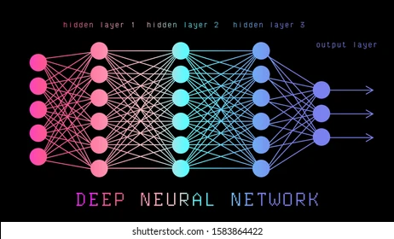
NEURAL NETWORK VS DEEP LEARNING
Deep Learning and neural networks tend to be used interchangeably in conversation, which can be confusing. As a result, it’s worth noting that the “deep” in deep learning is just referring to the depth of layers in a neural network. A neural network that consists of more than three layers—which would be inclusive of the inputs and the output—can be considered a deep learning algorithm. A neural network that only has two or three layers is just a basic neural network.
Notes:
While it was implied within the explanation of neural networks, it’s worth noting more explicitly. The “deep” in deep learning is referring to the depth of layers in a neural network. A neural network that consists of more than three layers—which would be inclusive of the inputs and the output—can be considered a deep learning algorithm. Most deep neural networks are feed-forward, meaning they flow in one direction only from input to output. However, you can also train your model through backpropagation; that is, move in opposite direction from output to input. Backpropagation allows us to calculate and attribute the error associated with each neuron, allowing us to adjust and fit the algorithm appropriately.

