Slide 1
Basic concept of clustering

Slide 2
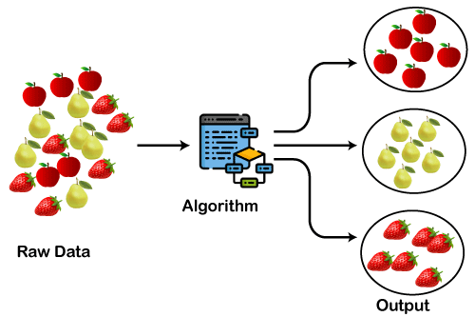
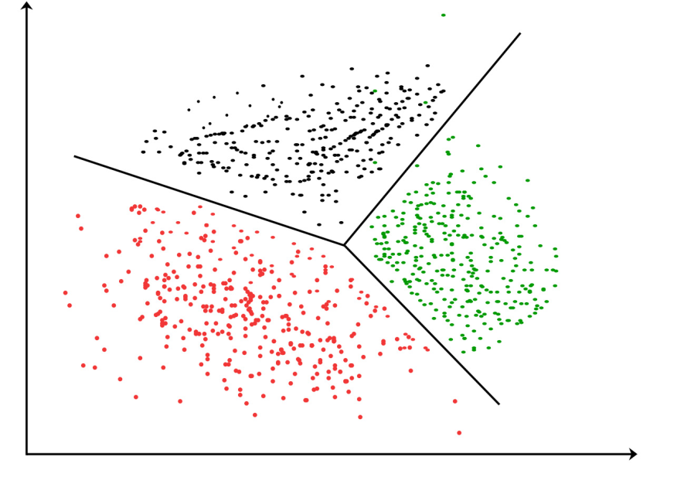
INTRODUCTION TO CLUSTERING
It is basically a type of unsupervised learning method . Generally, it is used as a process to find meaningful structure, explanatory underlying processes, generative features, and groupings inherent in a set of examples.
Clustering is the task of dividing the population or data points into a number of groups such that data points in the same groups are more similar to other data points in the same group and dissimilar to the data points in other groups.

Slide 3
WHY CLUSTERING ?
Clustering is very much important as it determines the intrinsic grouping among the unlabeled data present.
For instance, we could be interested in finding representatives for homogeneous groups (data reduction), in finding “natural clusters” and describe their unknown properties (“natural” data types), in finding useful and suitable groupings (“useful” data classes) or in finding unusual data objects (outlier detection).
This algorithm must make some assumptions which constitute the similarity of points and each assumption make different and equally valid clusters.

Slide 4
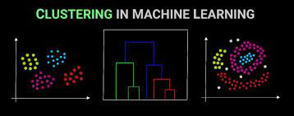
CLUSTERING METHODS
Density-Based Methods: These methods consider the clusters as the dense region having some similarity and differences from the lower dense region of the space. Example DBSCAN, OPTICS etc.
Hierarchical Based Methods: The clusters formed in this method forms a tree-type structure based on the hierarchy. New clusters are formed using the previously formed one. Example CURE, BIRCH etc.
It is divided into two category.
Agglomerative (bottom up approach)
Divisive (top down approach)
Grid-based Methods: In this method the data space is formulated into a finite number of cells that form a grid-like structure. Example STING, wave cluster, CLIQUE, etc.
Partitioning Methods: These methods partition the objects into k clusters and each partition forms one cluster. Example K-means, CLARANS, etc.

Slide 5
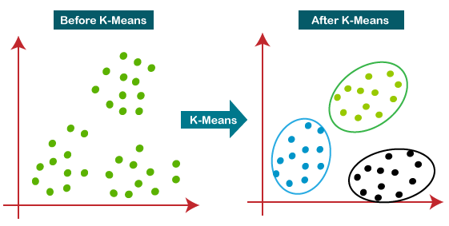
CLUSTERING ALGORITHMS
K-means clustering algorithm – It is the simplest unsupervised learning algorithm that solves clustering problems. K-means algorithm partition n observations into k clusters where each observation belongs to the cluster with the nearest mean serving as a prototype of the cluster.

Slide 6
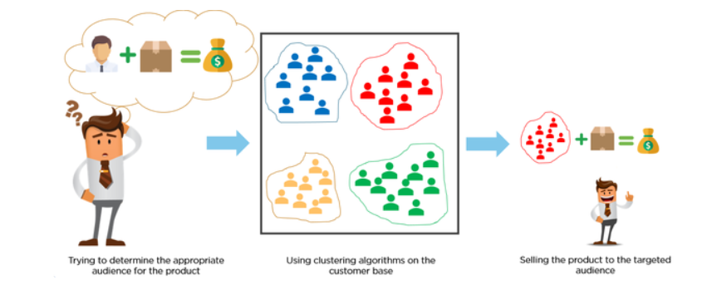
APPLICATIONS of Clustering in different fields
Marketing : It can be used to characterize & discover customer segments for marketing purposes.
Biology : It can be used for classification among different species of plants and animals.
Libraries : It is used in clustering different books on the basis of topics and information.
Insurance : It is used to acknowledge the customers, their policies and identifying the frauds.

