Slide 1
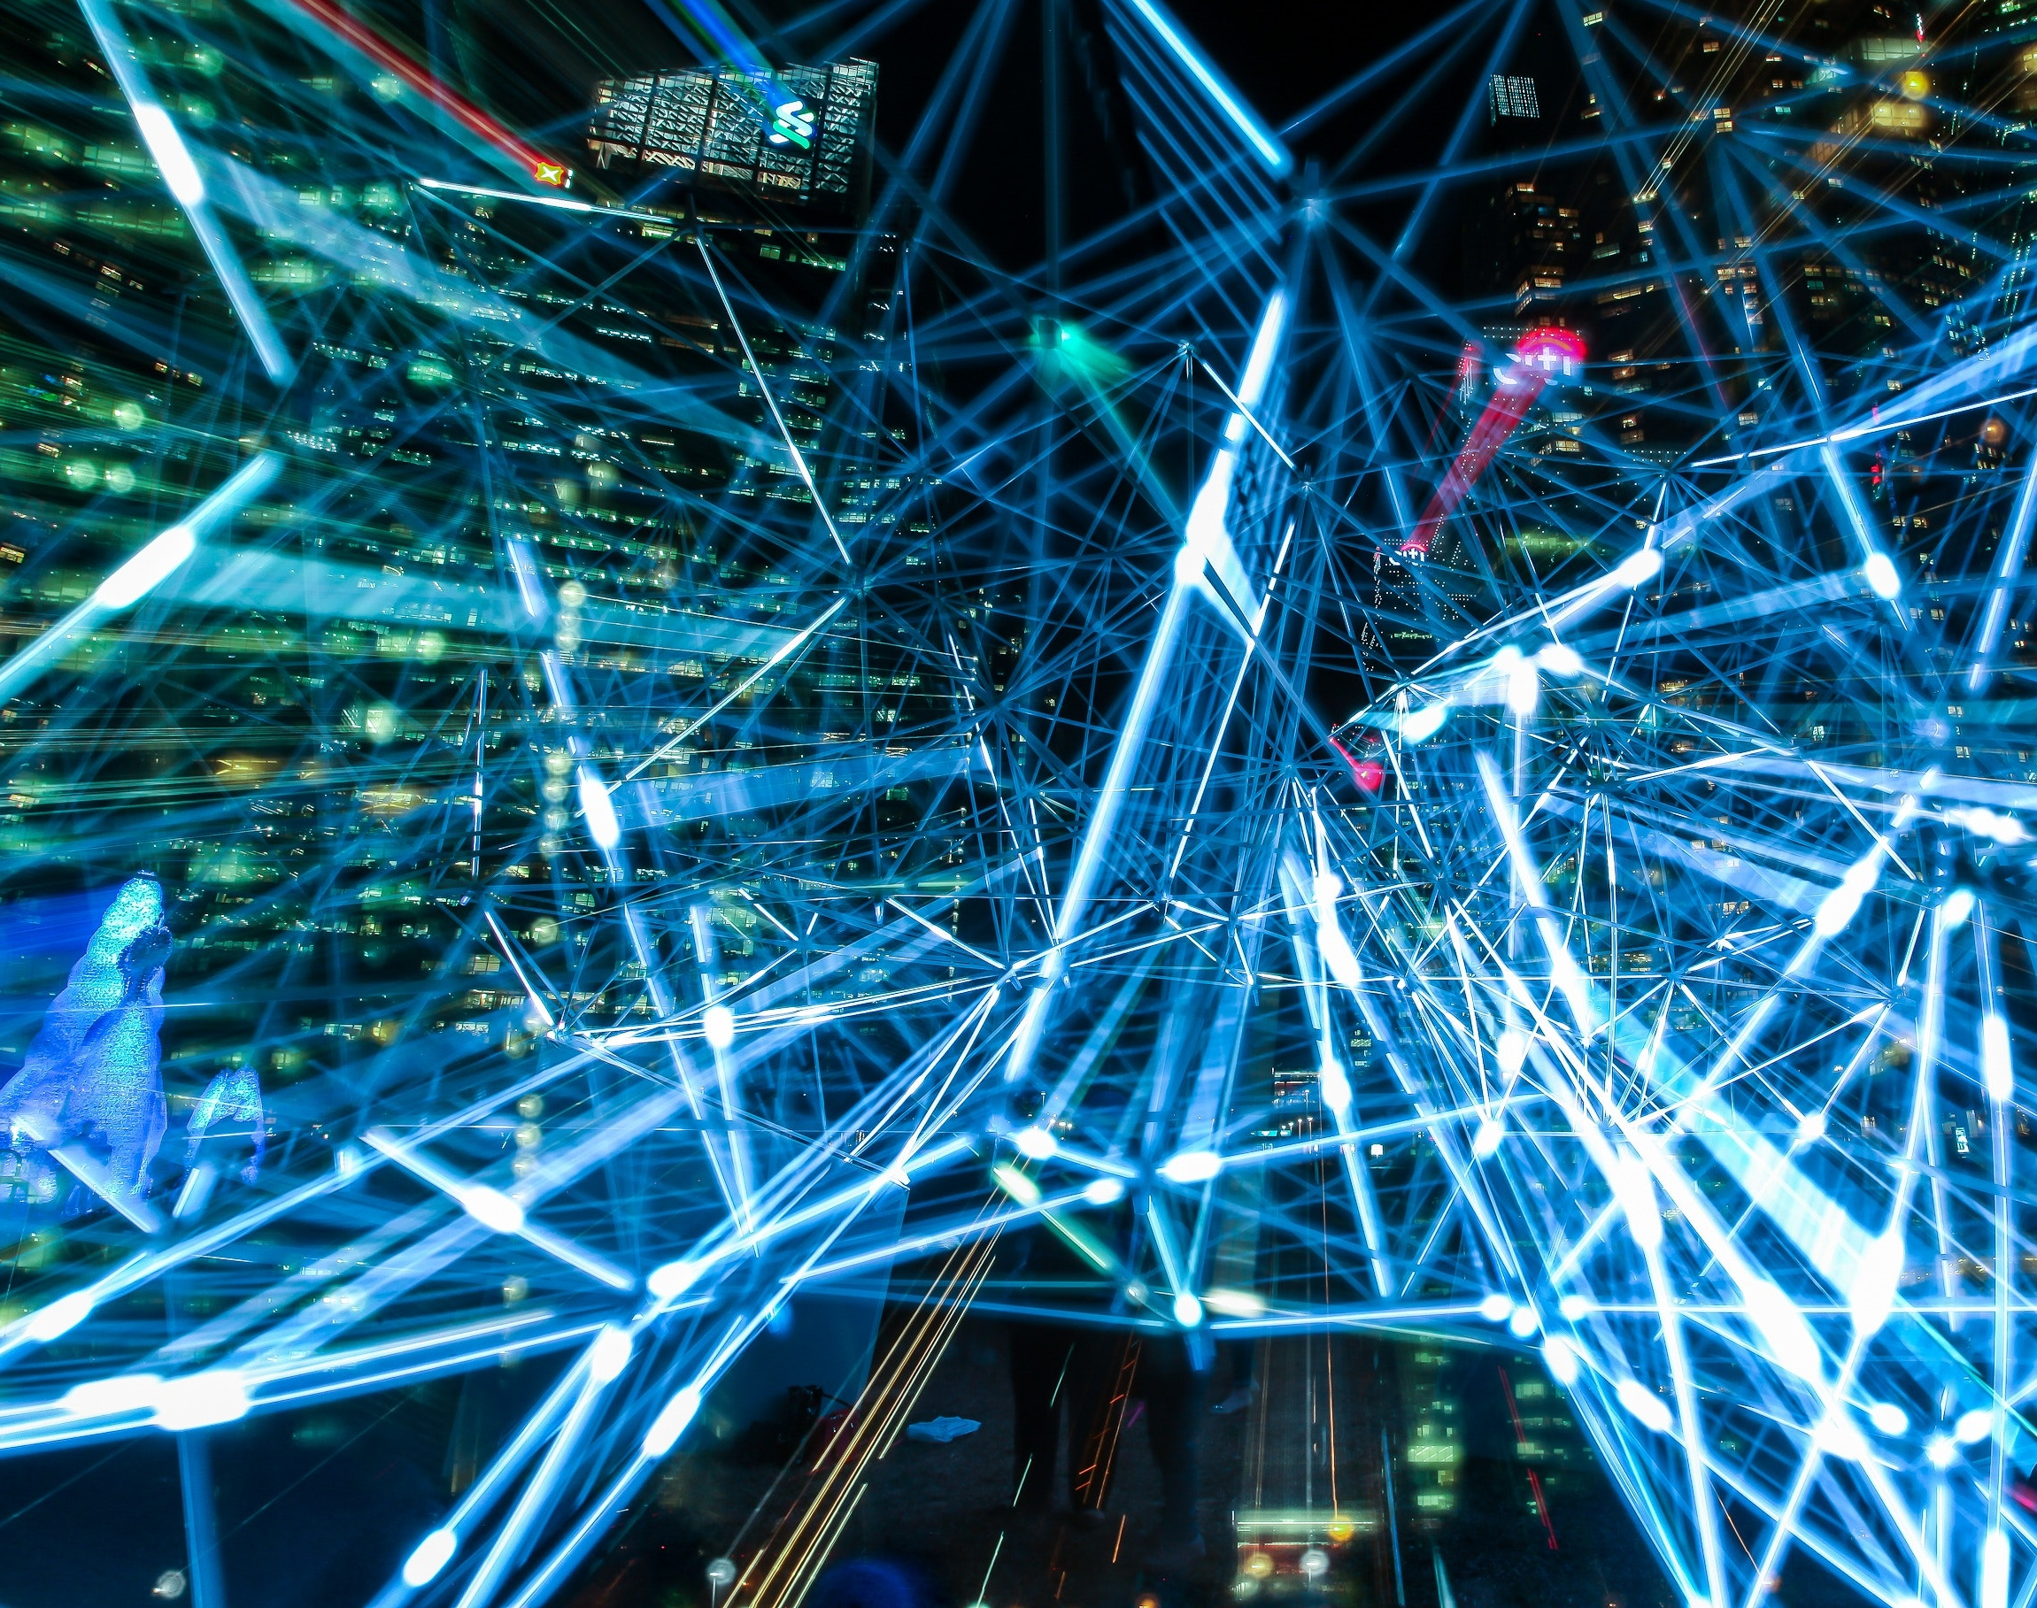
Core difference between Artificial Intelligence, Machine Learning and Deep Learning

Slide 2
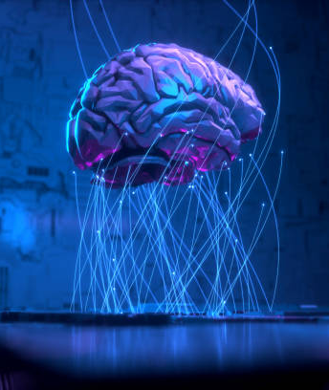
Artificial intelligence and how does it work?
Artificial intelligence is the simulation of human intelligence processes by machines, especially computer systems. Specific applications of AI include expert systems, natural language processing, speech recognition and machine vision
AI requires a foundation of specialized hardware and software for writing and training machine learning algorithms. No one programming language is synonymous with AI, but a few, including Python, R and Java, are popular..

Slide 3
Machine learning
What exactly is machine learning?
Machine learning is an application of artificial intelligence (AI) that provides systems the ability to automatically learn and improve from experience without being explicitly programmed.
Machine learning focuses on the development of computer programs that can access data and use it to learn for themselves.

Slide 4
Some Machine Learning Methods
Supervised machine learning algorithms can apply what has been learned in the past to new data using labeled examples to predict future events.
Unsupervised machine learning algorithms are used when the information used to train is neither classified nor labeled.
Semi-supervised machine learning algorithms fall somewhere in between supervised and unsupervised learning, since they use both labeled and unlabeled data for training – typically a small amount of labeled data and a large amount of unlabeled data.
Reinforcement machine learning algorithms is a learning method that interacts with its environment by producing actions and discovers errors or rewards.

Slide 5
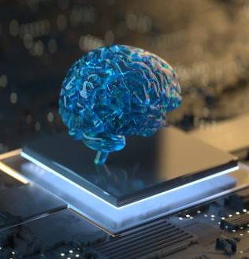
Deep Learning
Deep learning is a type of machine learning and artificial intelligence (AI) that imitates the way humans gain certain types of knowledge.
Deep learning is an important element of data science, which includes statistics and predictive modeling.
It is extremely beneficial to data scientists who are tasked with collecting, analyzing and interpreting large amounts of data; deep learning makes this process faster and easier.

Slide 6
What's the Difference Between AI, Machine Learning, and Deep Learning?
AI means getting a computer to mimic human behavior in some way.
Machine learning is a subset of AI, and it consists of the techniques that enable computers to figure things out from the data and deliver AI applications.
Deep learning, meanwhile, is a subset of machine learning that enables computers to solve more complex problems.

Slide 7
THANK YOU

